Slide 1



Online Food Delivery
SQL Project Report
Project Report
Bharti Manjhi
bhartimanjhi54@gmail.com

Slide 2
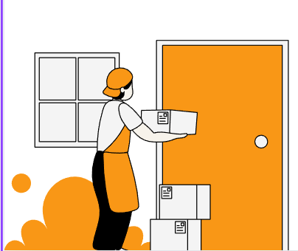
What the project is about
The Online Food Delivery Data Analysis Project aims to analyze and visualize customer, restaurant, and order data from an online food delivery platform using MySQL and Power BI.
The project helps in understanding:
  Customer behavior and spending patterns,
  Restaurant performance and revenue generation,
  Order trends across different cities,
  Price and demand of food items

Slide 3
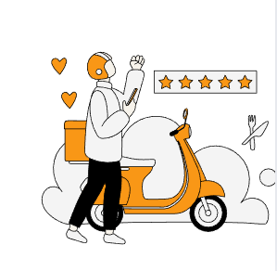
Problem Statements
The online food industry handles large volumes of data daily, making it difficult to manually identify, This project solves these problems by building an end-to-end analytical pipeline using SQL for data extraction and Power BI for visualization:
  Which restaurants generate the most revenue,
  Who are the top customers,
  What are the most frequently ordered or expensive items,
  How city-based demand varies (Metro vs Non-Metro), and
  Average order values by different cities.
  Top Spending customers
  Top High vs low order values.
  Customers by rewarded tiers.
  Top restaurants by city.

Slide 4

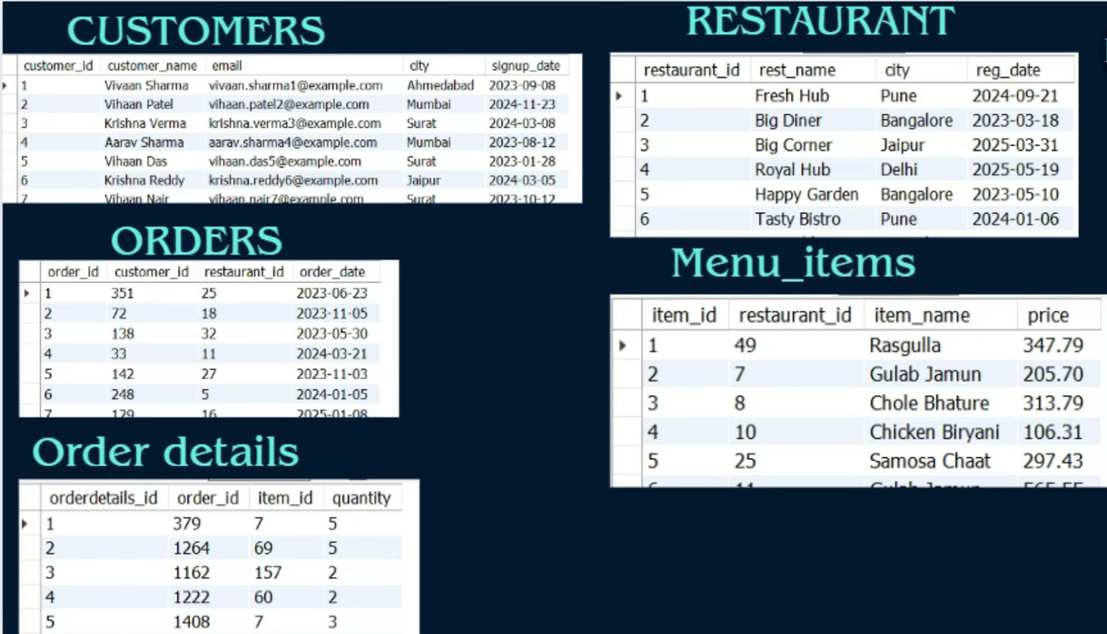
Dataset & Schema
The database schema stores online food delivery data with five tables — customers, restaurant, orders, menu_items, and order_details — linked through customer and restaurant IDs to track orders, items, and spending.

Slide 5
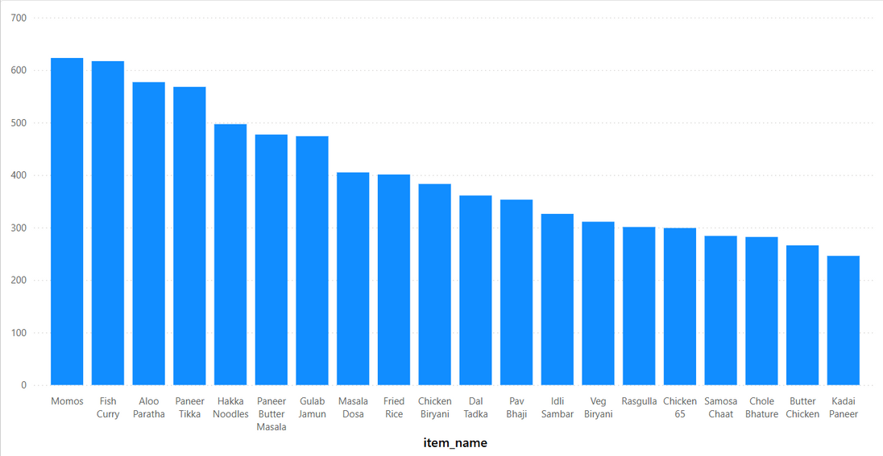
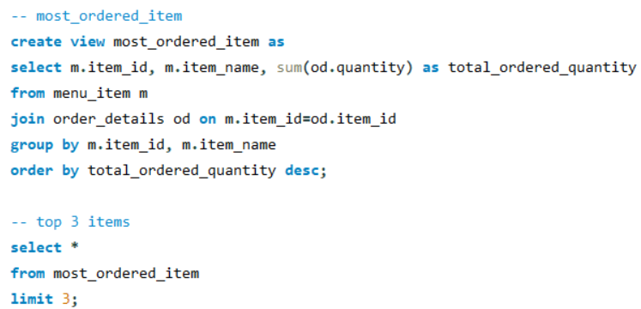
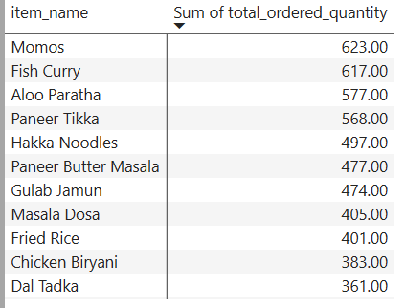
Queries & Methods
Q1: Most Ordered Items

Slide 6
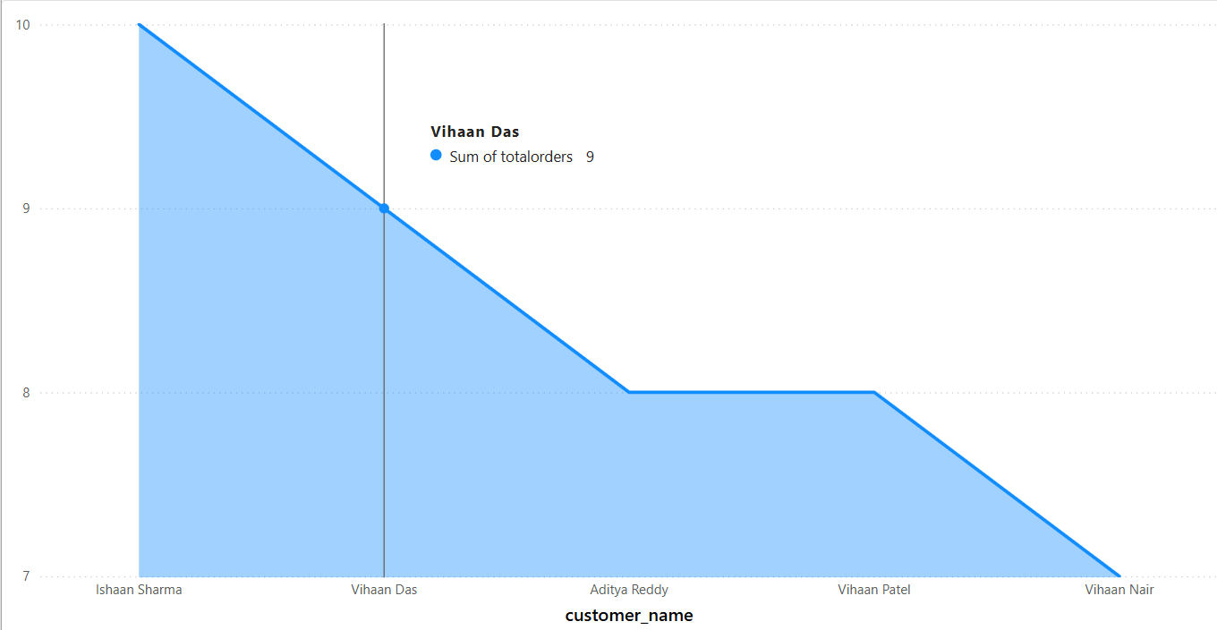
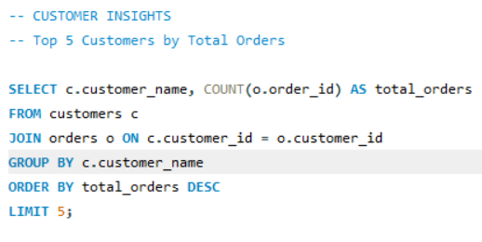
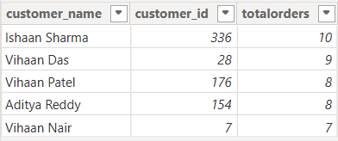
Queries & Methods
Q2: Top 5 Customers based on total orders placed

Slide 7
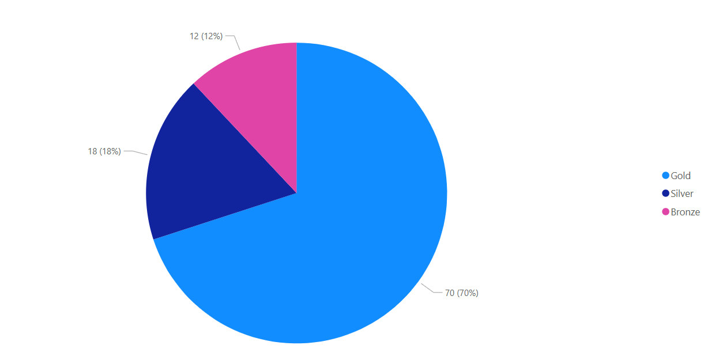
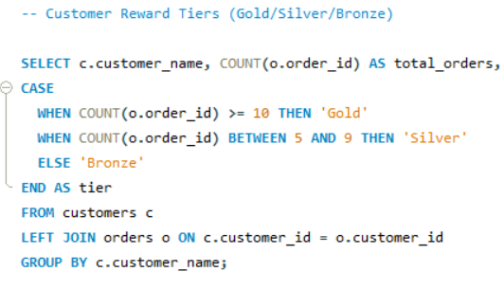
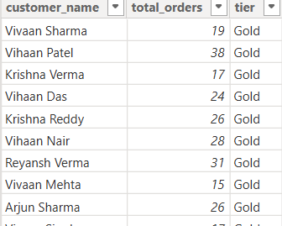
Queries & Methods
Q3: customer Reward Tiers (Gold/Silver/Bronze)

Slide 8
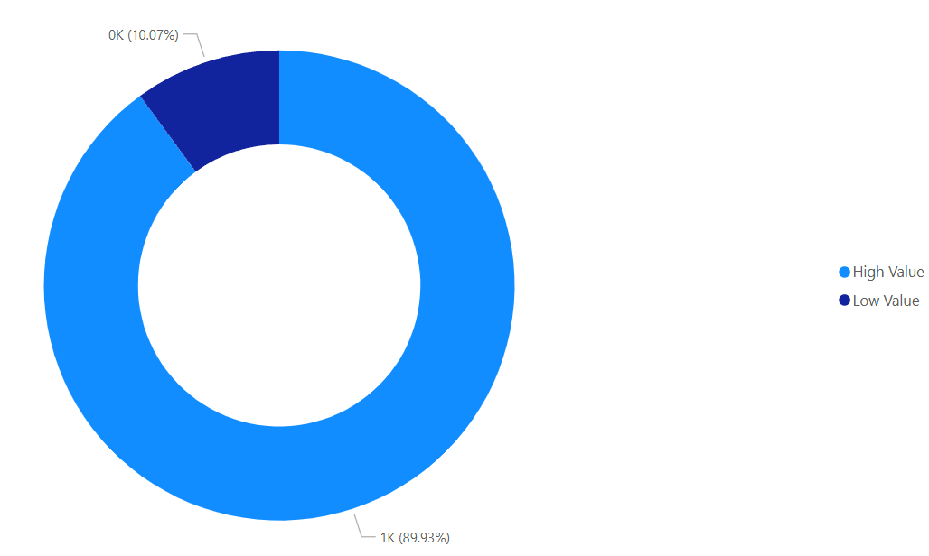
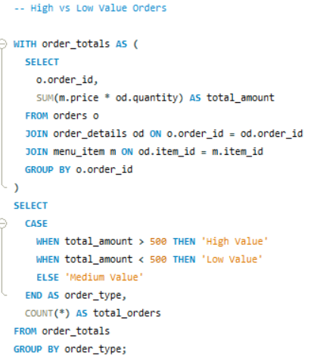

Queries & Methods
Q4: High & Low Value orders

Slide 9
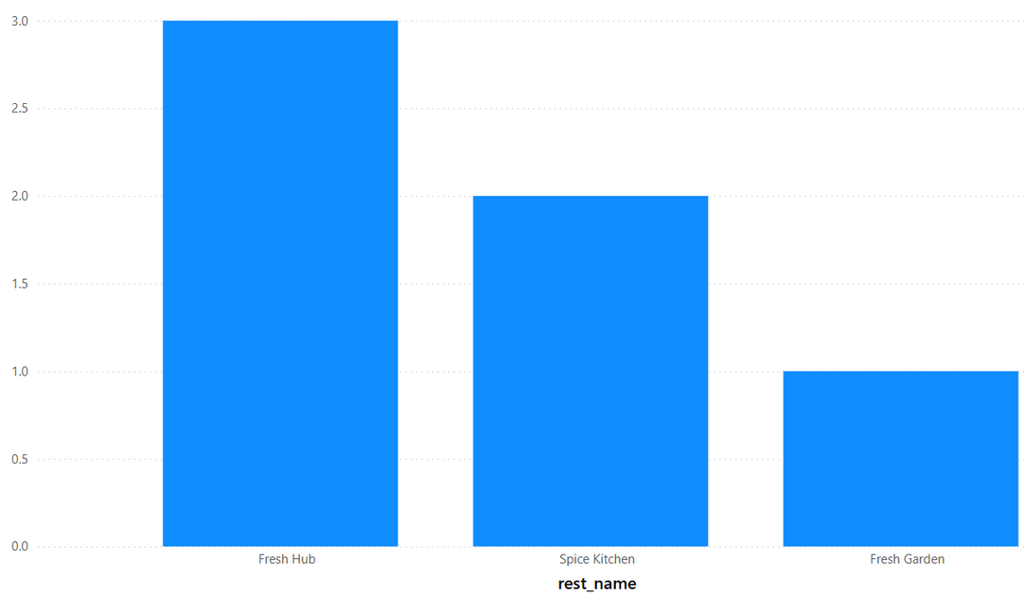
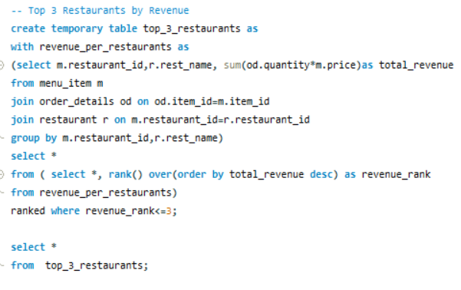
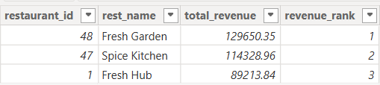
Queries & Methods
Q5: Top 3 Restaurants By Revenue

Slide 10
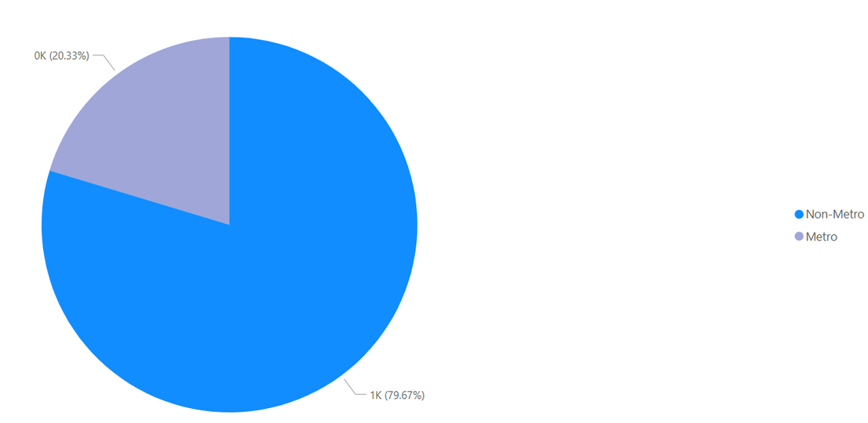
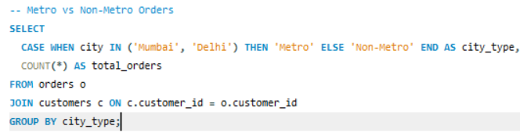

Queries & Methods
Q6: Metro vs Non Metro Customers

Slide 11
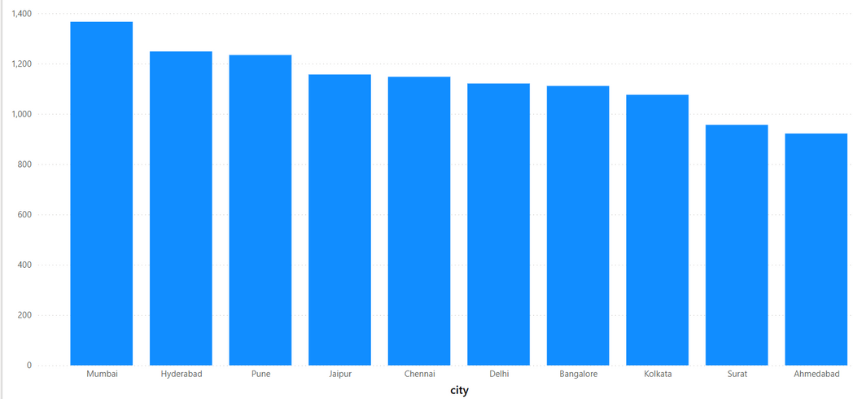
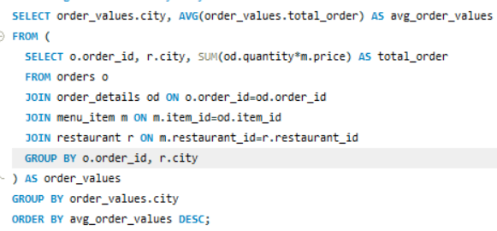
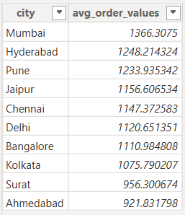
Queries & Methods
Q7: Average Order Value by city

Slide 12
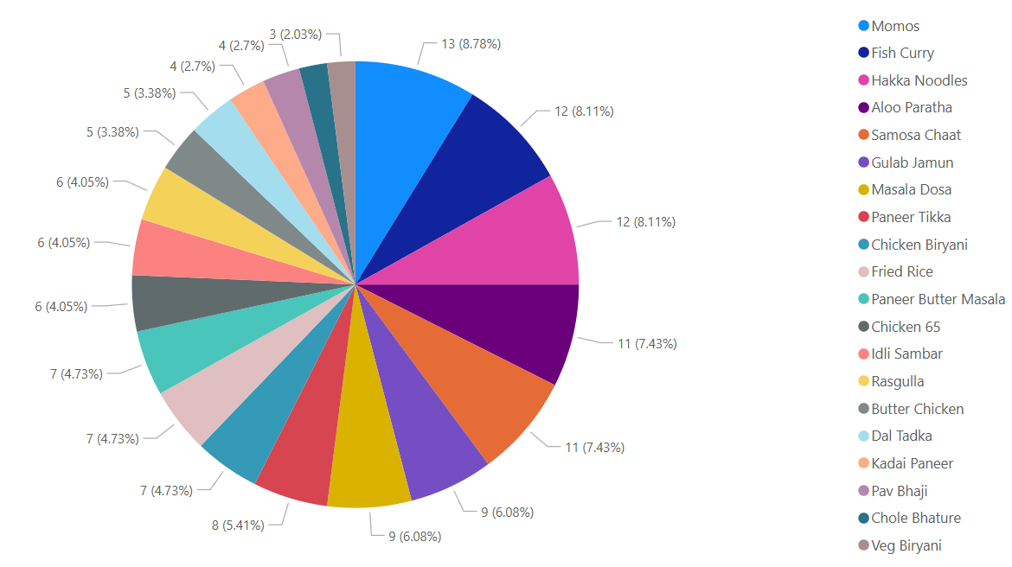
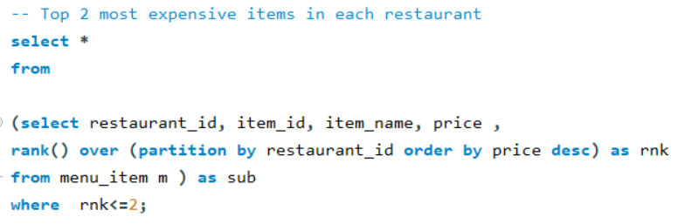
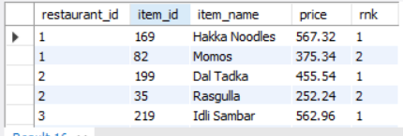
Queries & Methods
Q8: Top 2 Most expensive Items in each restaurant

Slide 13


Project Insights
Point 01
Point 02
Point 03
Customers consistently gravitate toward dishes like Momos, Fish Curry, and Aloo Paratha, making them the most frequently ordered items across restaurants. This strong preference highlights the importance of keeping these dishes well-stocked and prominently featured on menus and promotions.
A handful of loyal customers, such as Ishaan Sharma and Vihaan Das, have placed the highest number of orders, showing strong engagement. With 70% of users falling into the Gold tier, there’s a clear opportunity to nurture this loyalty through targeted rewards, exclusive deals, or early access to new offerings
Spending behavior is also encouraging — nearly 90% of all orders exceed ₹500, especially in cities like Mumbai and Hyderabad where average order values are the highest. This suggests that customers are comfortable spending more, which opens doors for upselling and premium combos.

Slide 14
Project Insights
Point 04
Point 05
Point 06
When it comes to revenue, Fresh Garden leads the pack, followed by Spice Kitchen and Fresh Hub. This ranking not only reflects customer preference but also helps identify which outlets are performing well and which may need strategic support.
Interestingly, Non-Metro cities account for nearly 80% of total orders, revealing a strong customer base outside major urban centers. This insight can guide expansion plans, regional marketing, and delivery optimization.
Lastly, premium items like Hakka Noodles (₹567) and Dal Tadka (₹365) stand out as the most expensive across restaurants. These dishes can be positioned as signature offerings, and their pricing can be evaluated to ensure they align with customer expectations and perceived value.

Slide 15

Conclusion & Recommendations
The data tells a clear story — customers really enjoy dishes like Momos and Fish Curry, making them the top favorites across restaurants. Most people are placing high-value orders, which shows they’re happy to spend more for good food. Interestingly, most of the orders are coming from smaller, non-metro cities, proving that the brand’s reach is growing beyond big cities. Restaurants like Fresh Garden are doing very well, while others like Fresh Hub have room to grow. Overall, the results show strong customer loyalty, healthy spending habits, and great opportunities to expand and improve service in new areas.
The business focus on attracting more customers from smaller cities, as they already make most of the orders. High-performing restaurants like Fresh Garden can guide others to improve. Loyal customers deserve special offers to keep them engaged, while promoting premium dishes and combo meals can boost overall sales. Strengthening delivery in non-metro areas and supporting weaker outlets will help the business grow faster and keep customers satisfied everywhere.

Slide 16

Thank You
+91 XXXXXXXX14
bhartimanjhi54@gmail.com

